Slide 1

Electrification, Automation, Shared Mobility, Micro-mobility and Transit Systems
Hannah DeBruin
Weekly Meeting: Transit Data Subgroup
9/21/22

Slide 2
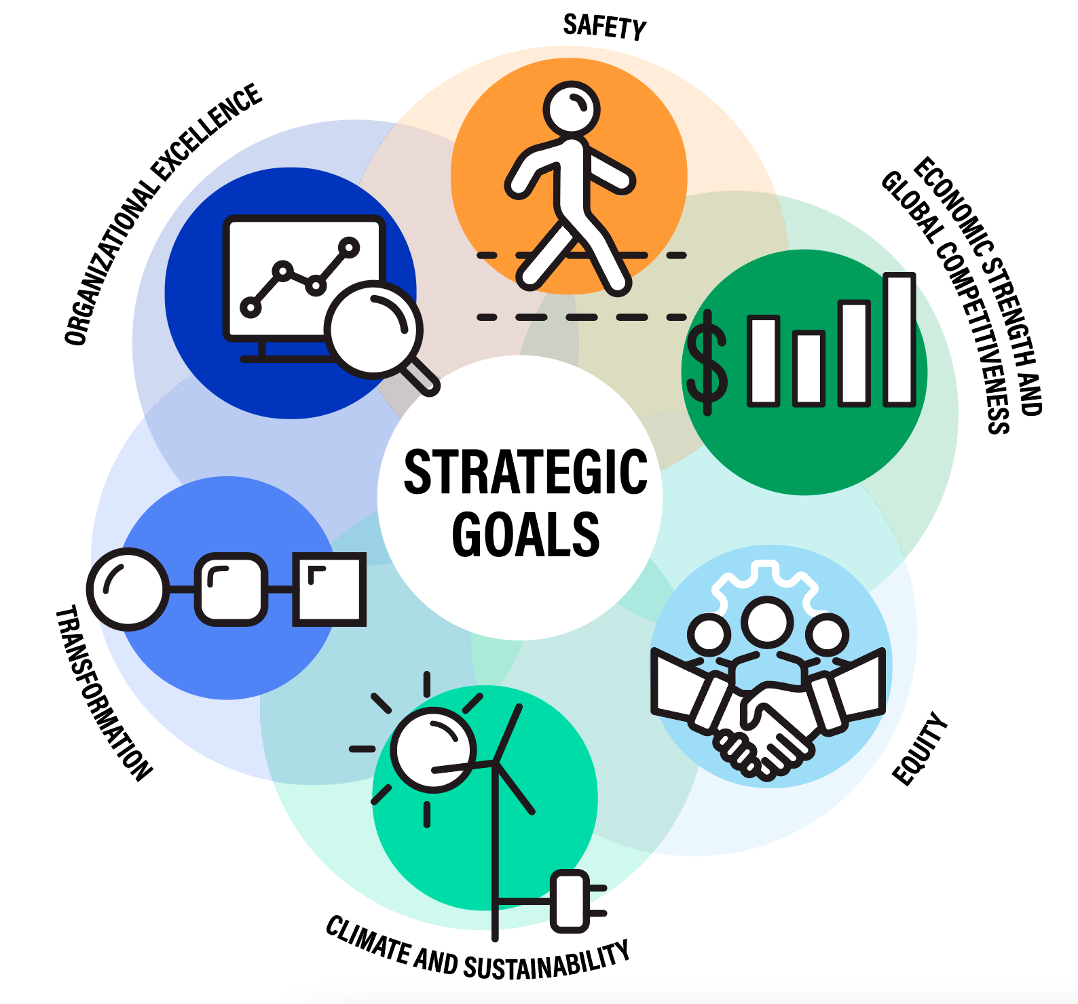
Overview of Considerations
Interactions between transit and new tech:
Ridership (mode choice)
Efficiency of transit operations (congestion of road network)
Funding (could tax revenue be generated from new tech?)
Land development patterns (could this technology contribute to sprawl?)
Network Positives/Concerns:
Comfort/safety
Environmental externalities (air quality, noise pollution, public health)
Serving mobility needs (peak, off-peak commutes, discretionary travel)
Operating costs (less drivers, cheaper fuel, etc)
DOT Strategic Goals

Slide 3
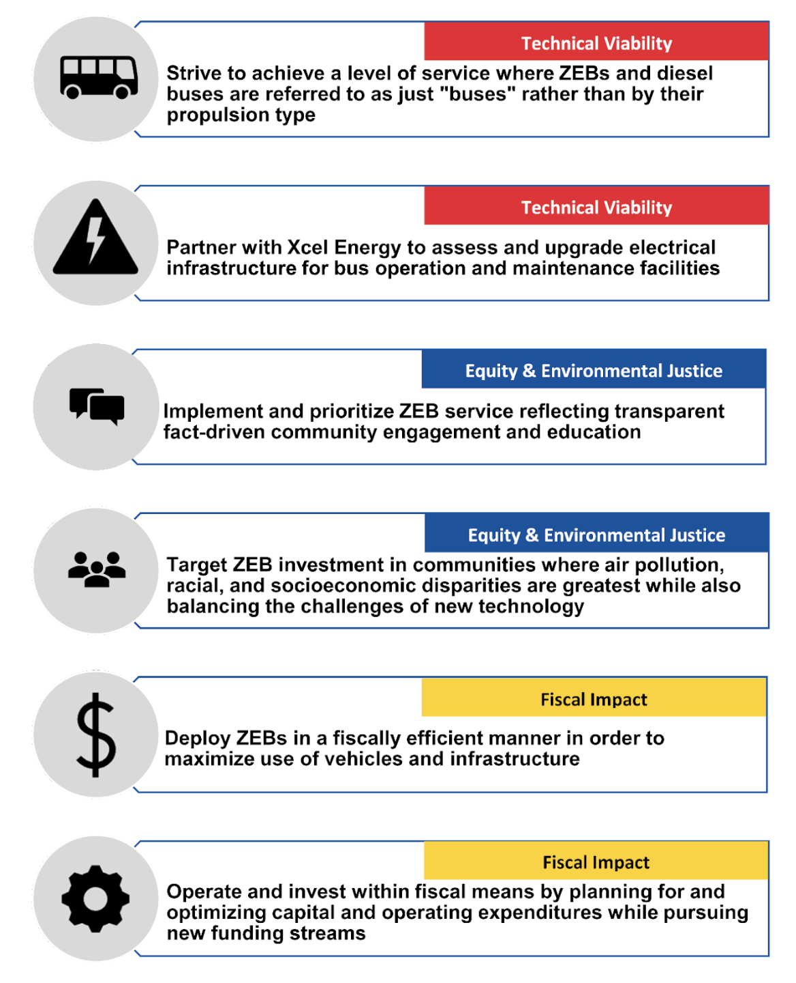
Electrification Complimenting Transit (Opportunities)
Fleet electrification – feasibility? Benefits? State of practice?? Policy incentives?
Vehicle range, charging, and route planning
Fleet replacement timeline planning (Metro Transit released a zero-emissions bus transition plan in February 2022, see figure to the right)
Generally lower operating costs
Park-and-ride charging – has this been implemented at all
Weekly Meeting (9/21/2022)
Hannah DeBruin

Slide 4
Electrification Competing with Transit (Risks)
Choice riders on the basis of environmental concerns might leave for PEV ownership – mode choice switch???
PEVs are still cars
Traffic congestion that interferes with transit operations
Parking requirements that contribute to land use sprawl, making walking/biking/transit more challenging
Weekly Meeting (9/21/2022)
Hannah DeBruin

Slide 5
Automation Complimenting Transit (Opportunities)
Autonomous transit vehicles – state of practice? feasibility? regulation?
Autonomous vehicles allow for more efficient system (they’re more predictable, less in the way of transit operations) – AV interaction with transit?
Good compliment for first/last mile door-to-door service
Generally safer for passengers and other road users
In a shared public system, might be more valid option for riders who prefer privacy, still less externalities than driving alone
Weekly Meeting (9/21/2022)
Hannah DeBruin

Slide 6
Automation Competing with Transit (Risks)
AVs are still cars
Still contribute to congestion (how much?)
If privately owned, same sprawl concerns for parking
Transit choice riders who value productivity in transit could switch modes – has this been studied?
Weekly Meeting (9/21/2022)
Hannah DeBruin

Slide 7
Shared Mobility Complimenting Transit (Opportunities)
First and last mile connections? – carsharing stations near transit stops??
More varied mobility needs can be met without individual car ownership (ie can use transit for commute, carshare for errands)
If taxed, could provide additional transit revenue
Less cars on the road -> less congestion, more safety, less sprawl, etc
In lower density areas, more demand-responsive transit (TNC)
Weekly Meeting (9/21/2022)
Hannah DeBruin

Slide 8
Shared Mobility Competing with Transit (Risks)
Mode switch (maybe only for certain trip purposes?)
Driver error can still cause collisions/congestion that limits transit safety and efficiency
Weekly Meeting (9/21/2022)
Hannah DeBruin

Slide 9
Micro-mobility Complimenting Transit (Opportunities)
First and last mile connections
Bikesharing stations near transit stops
Less cars on the road (less traffic congestion, collisions, sprawl, etc)
If taxed, could provide additional revenue for transit
Weekly Meeting (9/21/2022)
Hannah DeBruin

Slide 10
Micro-mobility Competing with Transit (Risks)
Could replace transit mobility in short trips?
Weekly Meeting (9/21/2022)
Hannah DeBruin

